Slide 1
Forms of Energy
Samuel DuPont 2009

Slide 2
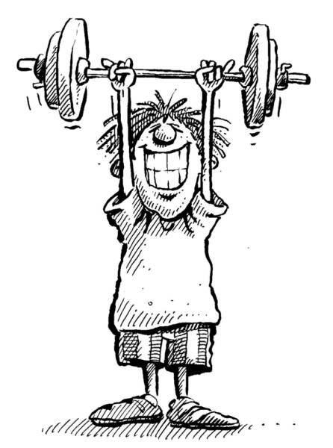
What is Energy?
Samuel DuPont 2009
Energy is..
  The ability to do work

Slide 3
Two Types of Energy
Potential
Kinetic

Slide 4
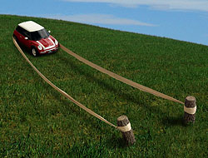
Potential Energy
Potential Energy:
  Stored Energy
Can you think of any other forms of potential energy?

Slide 5

Kinetic Energy
Energy in “Motion”
Can you think of any other forms of Kinetic energy?
Jumping out of a plane

Slide 6

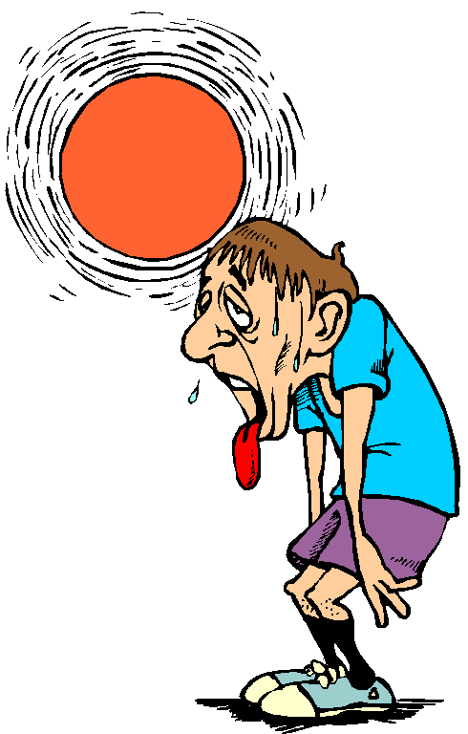
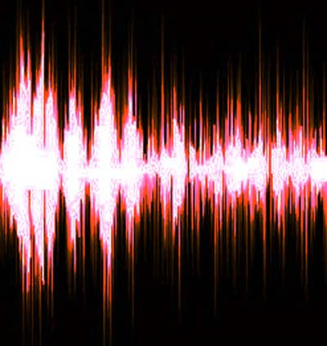
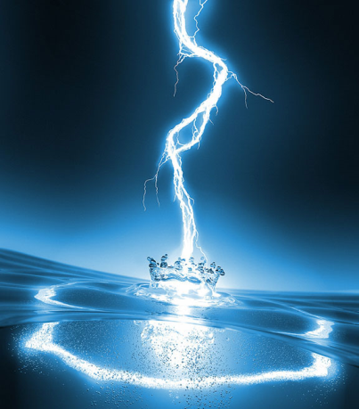
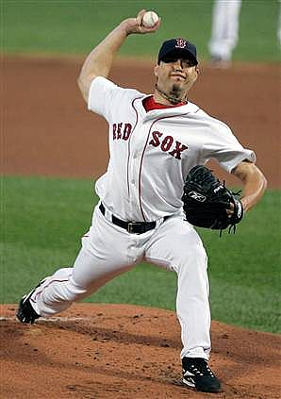
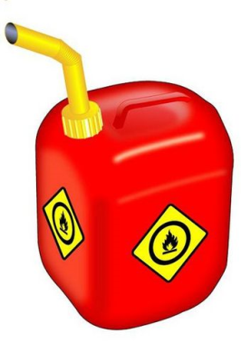
Are there different forms of energy?
Samuel DuPont 2009
Light
Heat
Sound
Electrical
Motion
Chemical

Slide 7
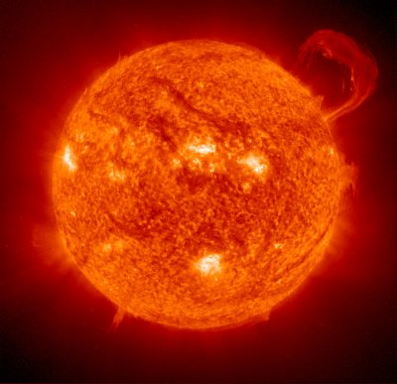
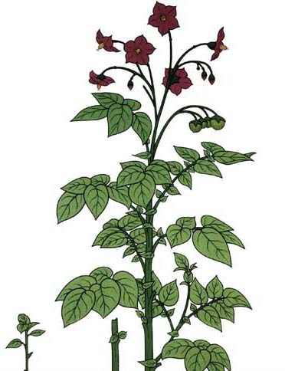
I see the Light!
Samuel DuPont 2009
Example of Light Energy:
The Sun
Question?
  Does the sun also have another form of energy?
  HEAT!
Fun Fact:
Plants use light energy to grow!

Slide 8
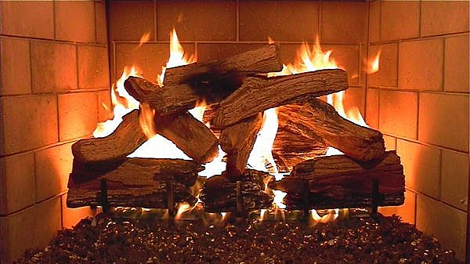


Is it getting Hot in here?
Samuel DuPont 2009
Example of Heat Energy:
Burning (Fire)
    Combustion is another word for Burn
Question:
What kind of “Work” can heat do for us?
Cooking
Keep us Warm

Slide 9



Sounds like energy to me
Samuel DuPont 2009
Example of Sound Energy:
Did you know:
Sound energy can break things like glass
Music
Notes:
Truerta.com

Slide 10




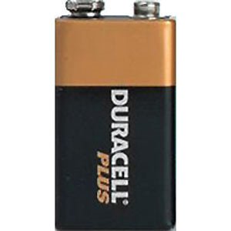

Now this is Electric!
Samuel DuPont 2009
Example of Electrical Energy
We use Electrical energy everyday!
Lighting

Slide 11
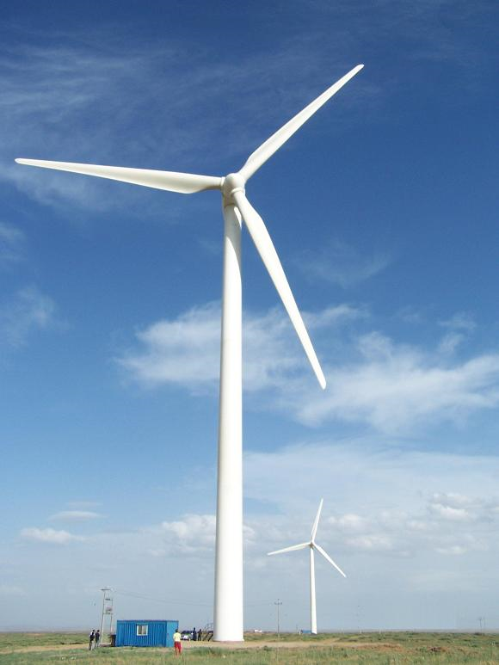

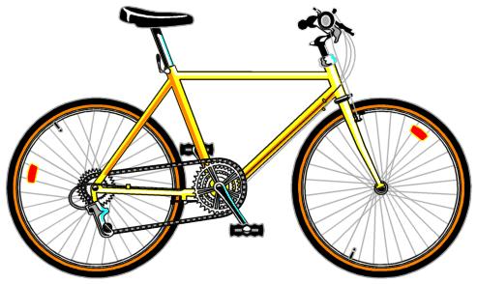
How can Energy move me?
Samuel DuPont 2009
Example of Motion Energy:
Energy of Motion is Everywhere!
Moves us around
Build things
Windmill

Slide 12
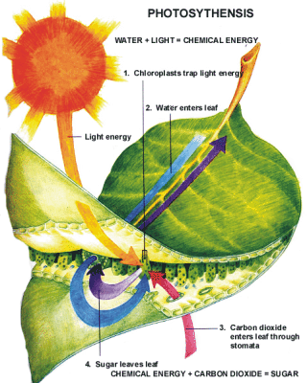
Chemical Energy
Energy in Fossil Fuels:
  Gasoline
  Natural Gas
  Oil
Energy in our bodies

Slide 13


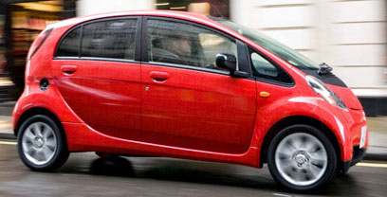
Chemical Energy
Most Chemical Energy is converted into other forms of energy:
  Gasoline → Heat
  Food → Motion
Other forms of energy change as well
  Light → Electricity (Solar)
  Gasoline → Motion (Car)
  Electricity → Light (light bulb)

